Slide 1
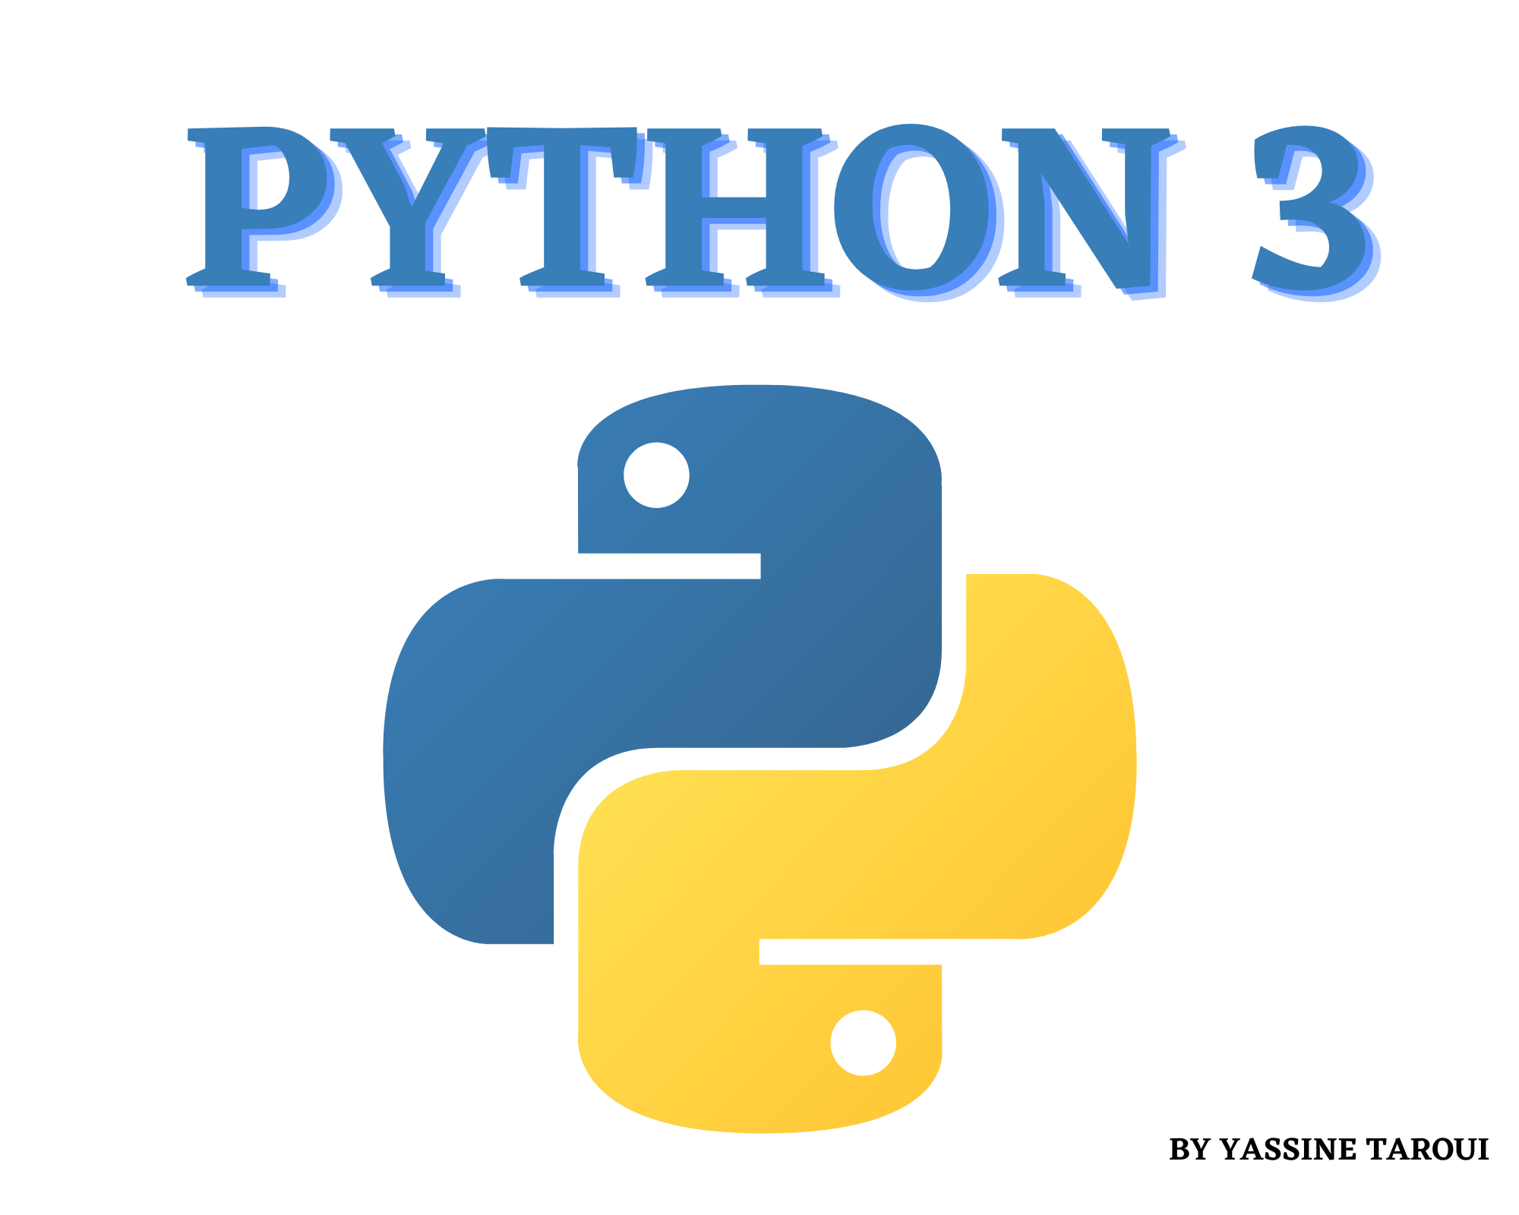

Slide 2


Print Function
print("Hello World")
print("Welcome to Python")
print("Happy Learning \nWelcome to Python")
Output
Hello World
Welcome to Python
Happy Learning
Welcome to Python

Slide 3
Variable
A=10
B='Data Science!'
print(A,B)
Output
10 Data Science!
#another example
x, y, z = 10, 20, 30
print(x)
print(y)
print(z)
Output
10
20
30

Slide 4
operators
# Arithmetic operators
a=50
b=40
print(a+b) Output 90 print(a-b) Output 10 print(a*b) Output 2000 print(a/b) Output 1.25 print(a%b) Output 10 print(a//b) Output 1 print(a**b) Output 90949470177292823791503906250000000000000000000
# Comparison Operator
a=50
b=100
print(a==b) Output false
print(a!=b) Output true
print(a>b) Output false
print(a<b) Output true
print(a>=b) Output false
print(a<=b) Output true

Slide 5
Datatypes
There are eight native datatypes in Python.
Boolean
Numbers
Strings
Bytes & Byte Arrays
Lists
Tuples
Sets
Dictionaries

Slide 6
#Boolean
number = [1,2,3,4,5]
boolean = 3 in number
print(boolean)
Output
True
#Numbers
num1 = 5**3
num2 = 32//3
num3 = 32/3
print('num1 is',num1)
print('num2 is',num2)
print('num3 is',num3)
Output
num1 is 125
num2 is 10
num3 is 10.666666666666666
#Strings
str1 = "Welcome"
str2 = " to python "
str3 = str1 + str2
print('str3 is',str3)
print(str3[0:10])
print(str3[-5:])
print(str3[:-5])
Output
str3 is Welcome to python
Welcome to
thon
Welcome to py

Slide 7
#Tuples sports_tuple = ('Cricket', 'Basketball', 'Football’) sports_list = list(sports_tuple) sports_list.append('Baseball’) print(sports_list) print(sports_tuple) Output ['Cricket', 'Basketball', 'Football', 'Baseball'] ('Cricket', 'Basketball', 'Football')
#Lists
name = ['yassine', 'ahmed', 'sofyan'']
print(len(name))
print(name)
name.append('yassine')
print(name)
name.insert(2, 'ahmed')
print(name)
Output
3
['yassine', 'ahmed', 'sofyan']
['yassine', 'ahmed', 'sofyan', 'yassine']
['yassine', 'ahmed', 'ahmed', 'sofyan', 'yassine']

Slide 8
If statement
If statement:
a = 33 b = 200 if b > a: print("b is greater than a")
output
b is greater than a

Slide 9
List Functions
len(list) Gives the total length of the list
max(list) Returns item from the list with max value.
min(list) Returns item from the list with min value.
list( seq ) Converts a tuple into list.

Slide 10
List methods
list.append(obj) Appends object obj to list
list.count(obj) Returns count of how many times obj occurs in list
list.extend(seq) Appends the contents of seq to list
list.index(obj) Returns the lowest index in list that obj appears
list.insert(index, obj) Inserts object obj into list at offset index
list.pop(obj=list[-1]) Removes and returns last object or obj from list
list.remove(obj) Removes object obj from list
list.sort([func]) Sorts objects of list, use compare func if given

Slide 11
Dictionary Methods
dict.clear() Removes all elements of dictionary dict.
dict.copy() Returns a shallow copy of dictionary dict.
dict.fromkeys()Create a new dictionary with keys from seq and values set to value.
dict.get(key, default=None) For key , returns value or default if key not in dictionary
dict.has_key(key) Removed, use the in operation instead.
dict.items() Returns a list of dict's (key, value) tuple pairs.
dict.keys() Returns list of dictionary dict's keys.
dict.setdefault(key, default=None) Similar to get(), but will set dict[key]=default if key is not already in dict.

Slide 12
Files I/O
Modes: methods:
w+ name
a+ mode
r+ closed
w flush
a read
r write
rb / rb+ readlines
ab / ab + writelines
wb / wb+

